Slide 1


Slide 2
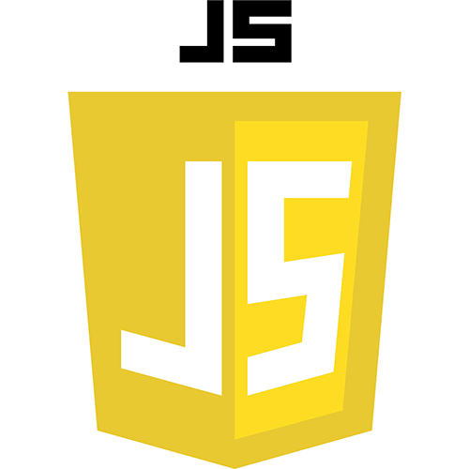

Slide 3
Build a RESTful API with Express, Node and MongoDB

Slide 4
02 Start a new Node project with Express web server
03 Parse request body
04 Build a Mongo DataBase
05 Build an Express router to handle requests
06 Implement a GET HTTP request
07 Implement a POST HTTP request
08 Implement a PUT HTTP request
09 Implement a PATCH HTTP request
10 Implement a DELETE HTTP request

Slide 5
Build a RESTful API with Validation

Slide 6
12 Build a Node web server with Express and Nodemon
13 Set up handlers for RESTful HTTP requests
14 Build a Mongo database
15 Use middleware to reduce code duplication / Respond to 'GET by Property' request
16 Respond and test an HTTP POST request
17 Implement Express validator for validation
18 API integration testing with Mocha and Supertest

